Slide 1
Te Marautanga o Aotearoa describes the essential knowledge, skills, values and attitudes appropriate to Māori-medium schools.
Following are the first few pages of Te marautanga (curriculum) o Aotearoa.
Just thinking ‘out loud’ here, but what aspects can we take from here to help reframe our thinking around courses, units, resources and activities?
Annotations and thoughts by Sue de Lautour, Drive Resources

Slide 2
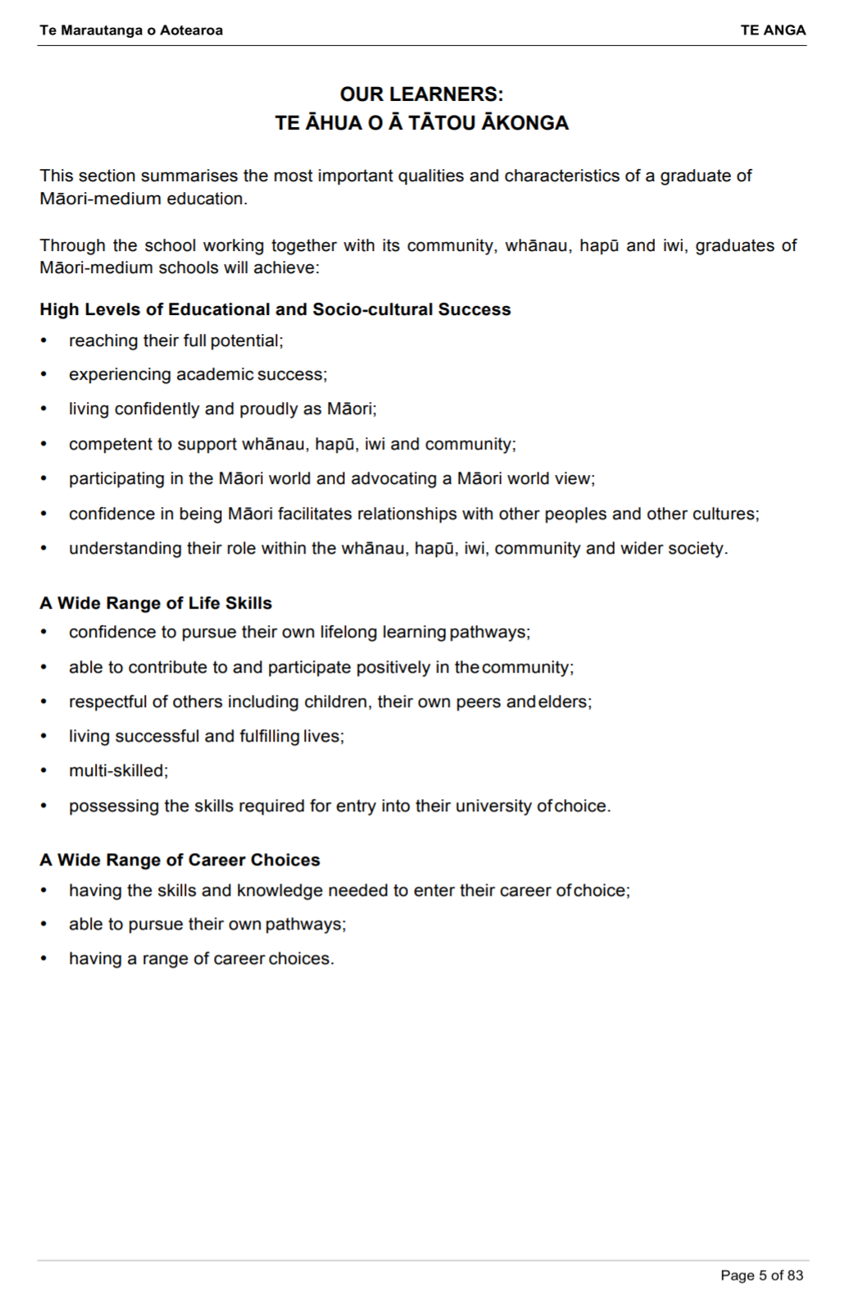
Supporters of and pride in Māori and wider society

Slide 3
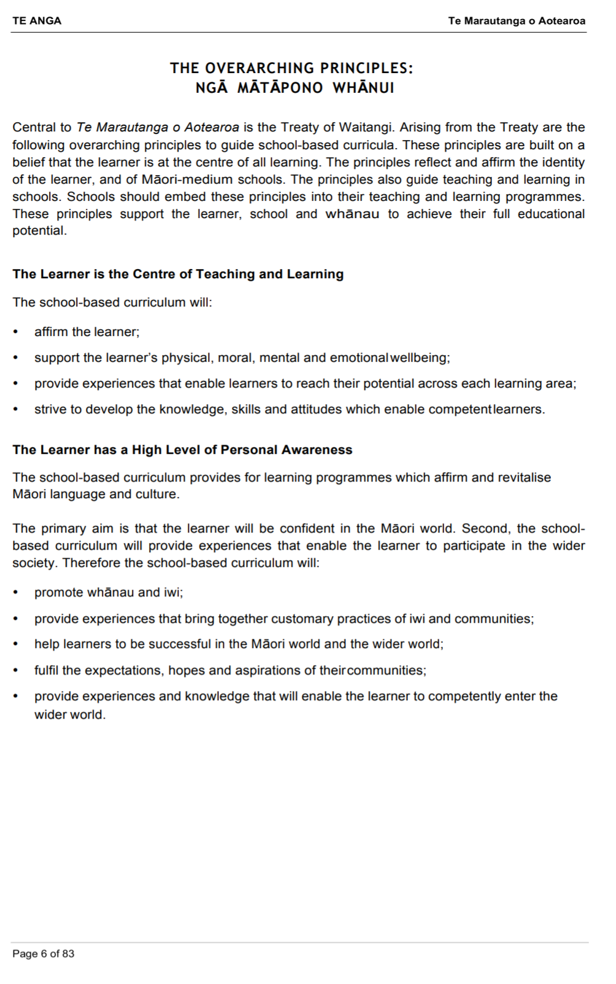
Whanau, iwi, community

Slide 4
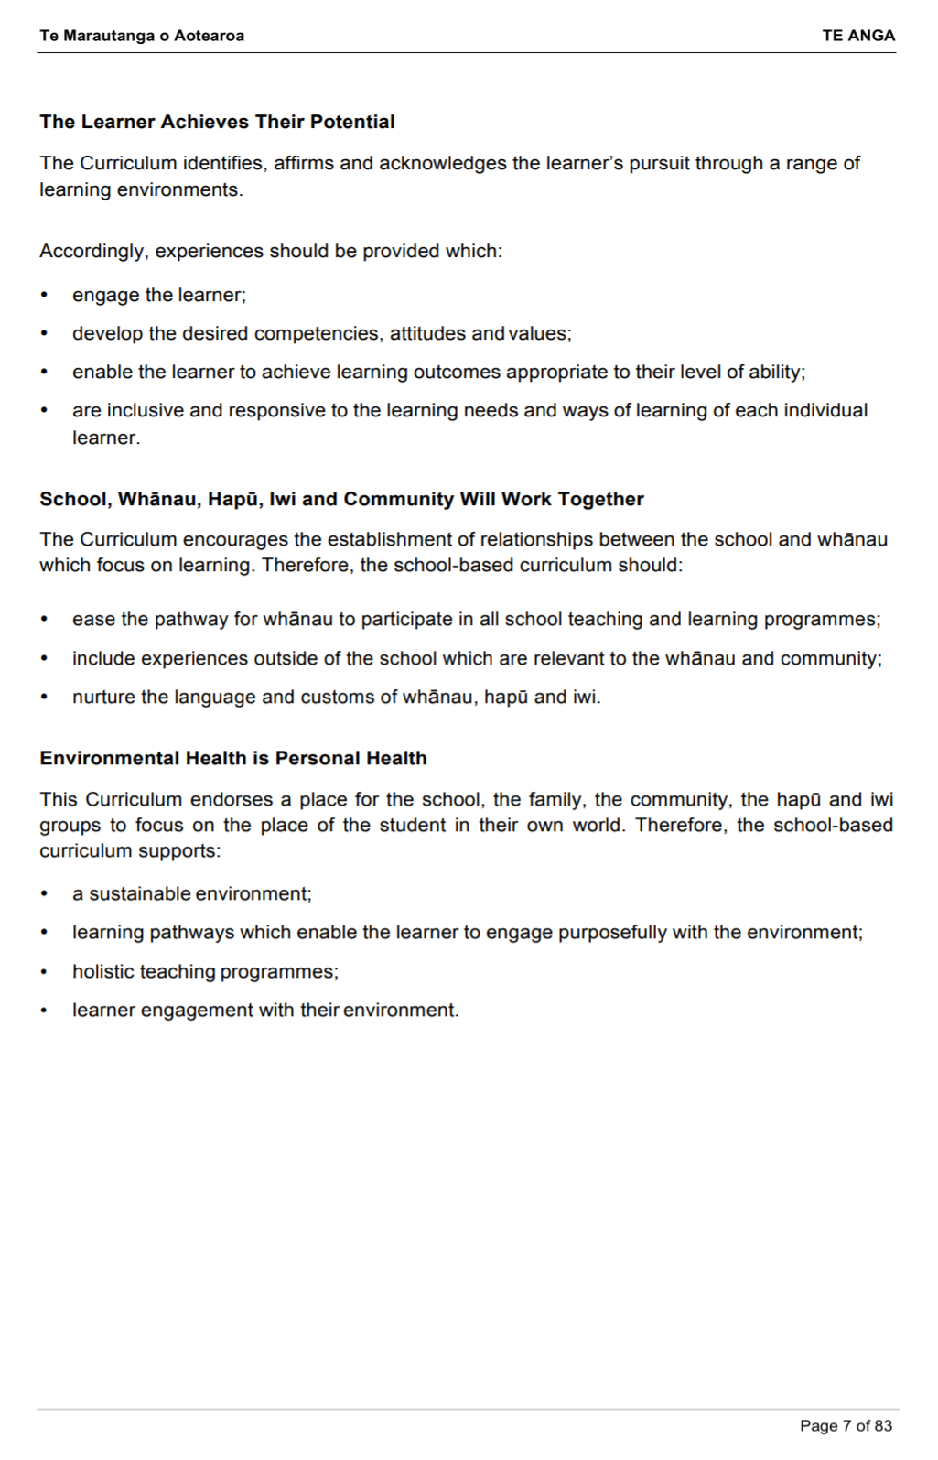
Individual learning needs and styles.
Relationships outside the classroom
Environment

Slide 5
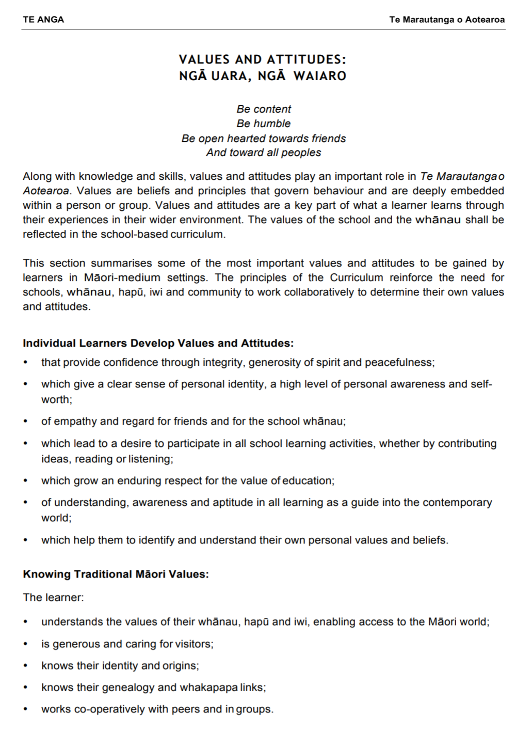
Personal identity,values, beliefs, awareness, self-worth.
Identity, origins, whakapapa

Slide 6
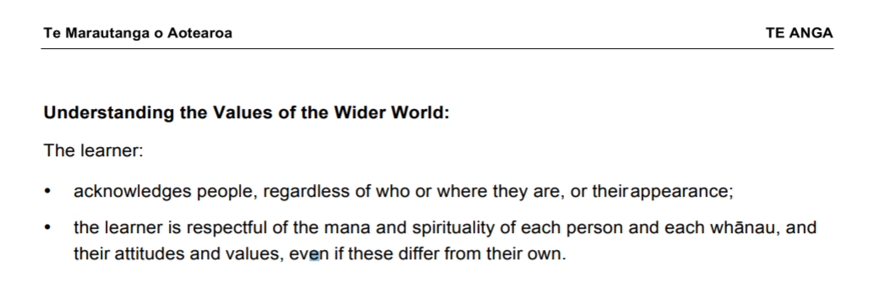

Slide 7
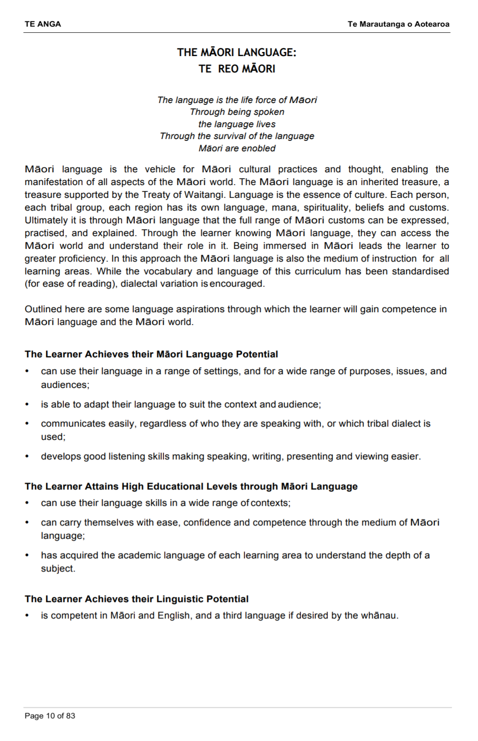

Slide 8
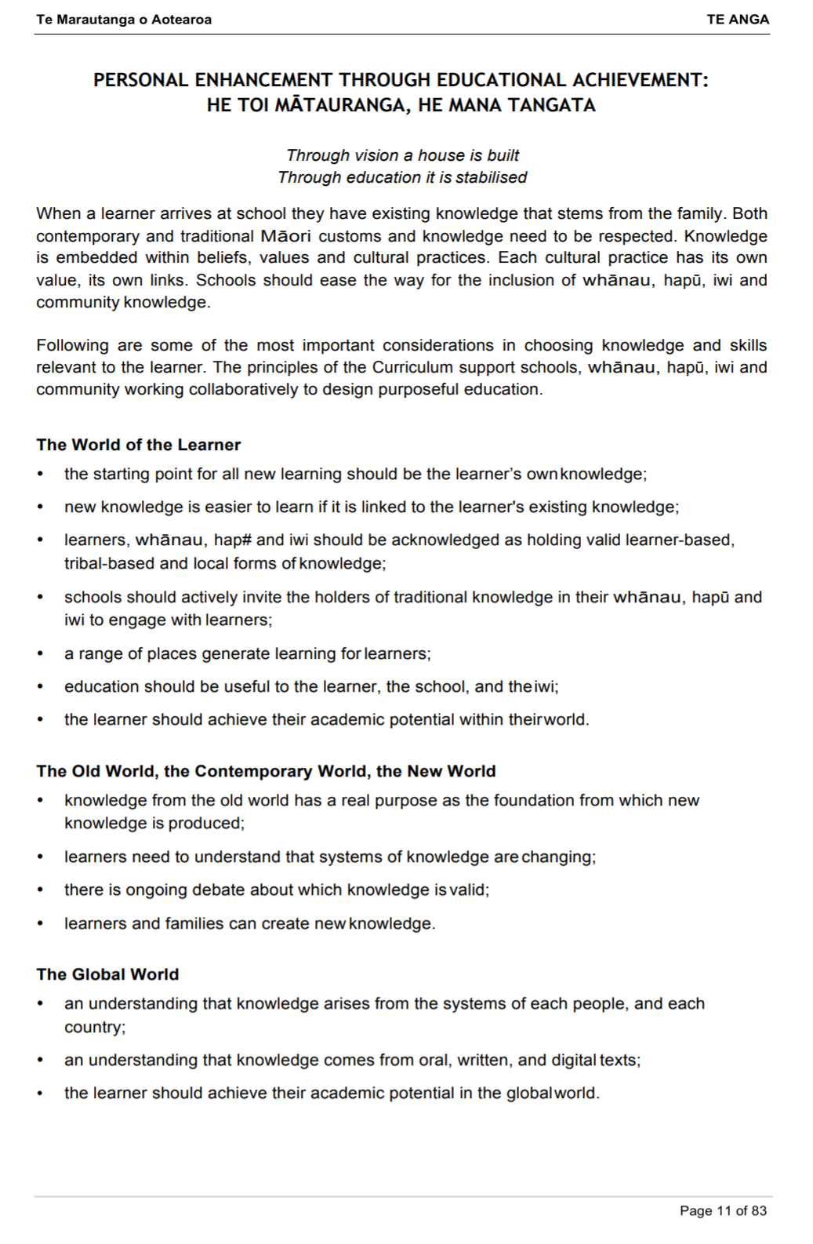
Noting why we need this skill/knowledge out in the real world.
Lots of potential here.
Interesting. What does it mean?
Compare Mātauranga Māori aspects to those from other cultures. Eg stars of Matariki.

Slide 9
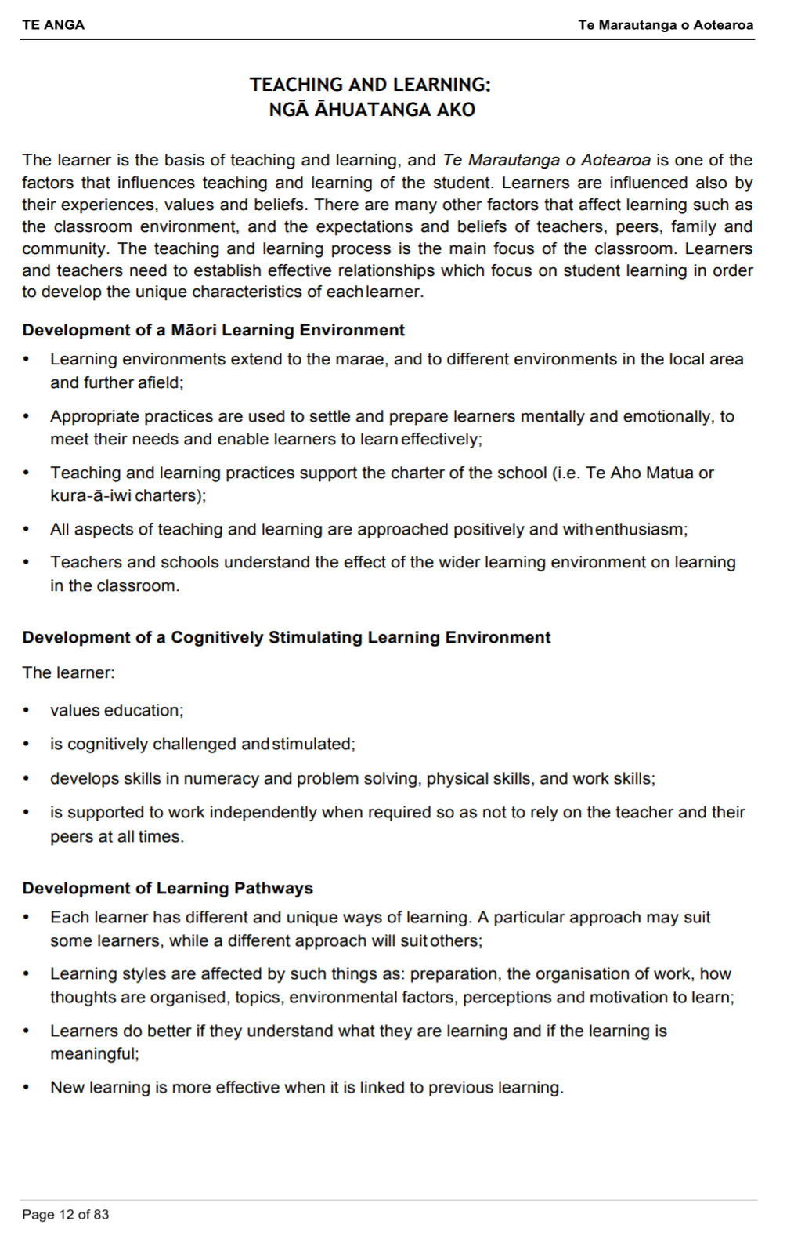
Learning outside the classroom.
Keep it meaningful

Slide 10
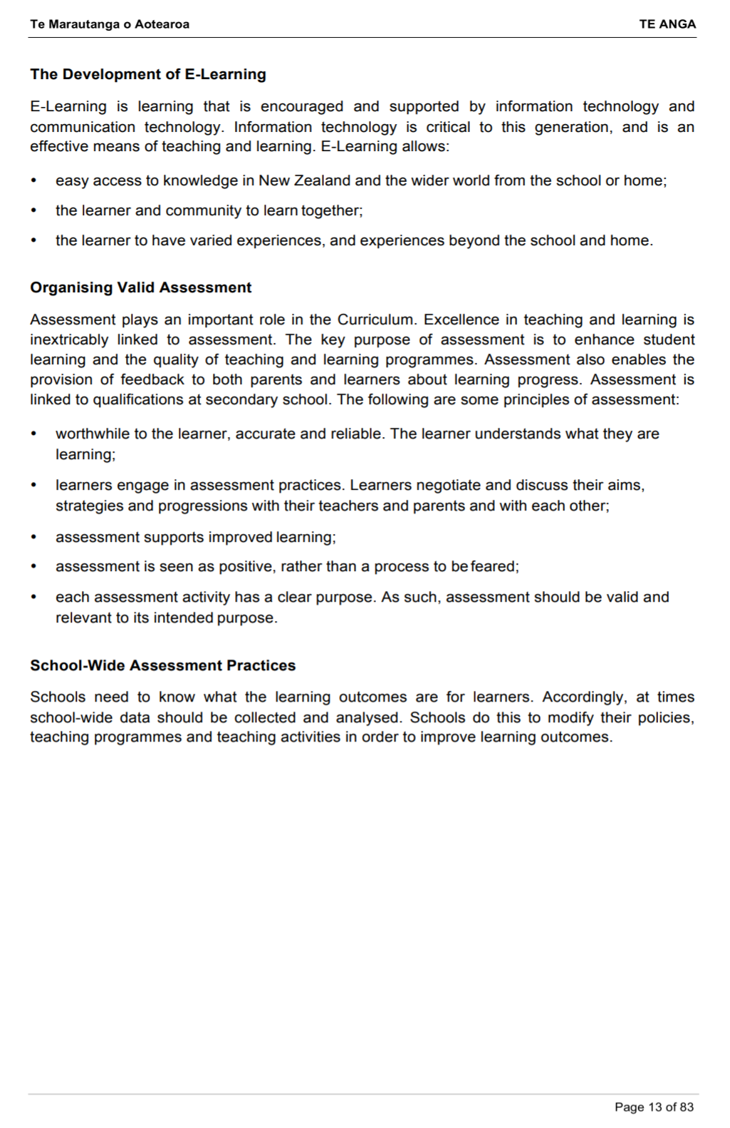
Students understand process, the learning.

